Slide 1
The Social Contract

Slide 2
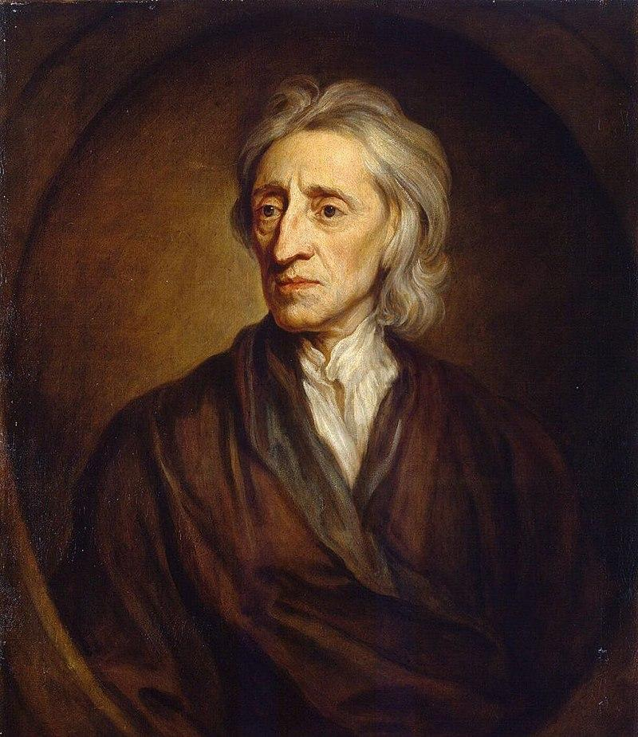
John Locke (1632-1704)
The Social Contract
State of Nature
Notes:
Locke is in many ways the person who began the modern conversation about government, laws and the legitimacy of the State.

Slide 3
The Social Contract is a fiction,
We forgo certain freedoms in exchange for security
Assumes Natural Rights (Locke)
'Natural' means they come either from God or universal consensus.
Notes:
Locke suggests we have something called “Natural Rights.” He claimed these came from God, but if you prefer you can also suggest they are natural in the sense that these rights are agreed upon by all.

Slide 4
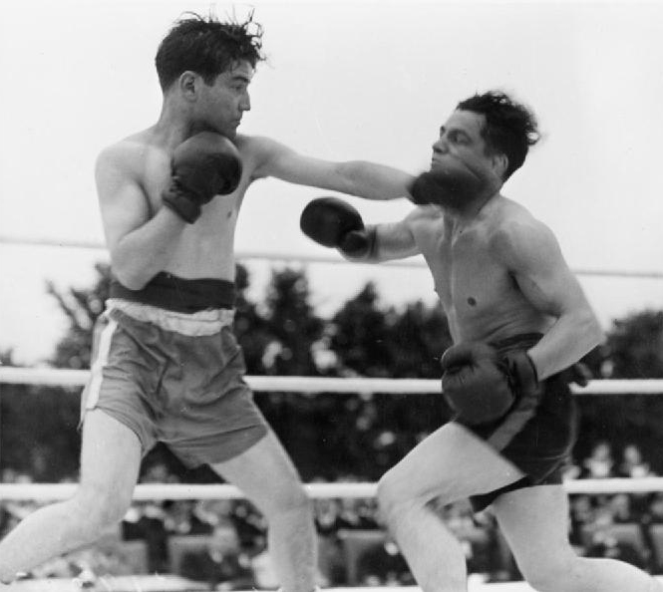
The Social Contract is a system of laws.
Puts limits on persons and states in order to protect Natural Rights.

Slide 5
Locke says the State cannot delegate Natural Rights such as:
Life
Health
Liberty
Private Property
Notes:
What are these rights? According to Locke these rights are the right to life, health, the freedom to act as one chooses, and the right to dispose of one’s property however one sees fit, so long as these rights do not interfere with other people’s exercise of the same rights. We also have certain moral obligations. We also have the right to defend these rights and punish those who would try to take them away. We have the right to seek compensation from those who violate them. When we violate the rights of others we remove ourselves from our natural rights and earn punishment.

Slide 6
To delegate them would be counter to the whole purpose of the Social Contract
No person can delegate right to
Life
Property
Freedom

Slide 7
It is a non-existent right to violate the rights of others
Notes:
Importantly, Locke does not see these rights as granted by the state, but rather they exist with or without a state.
In order to enforce these rights people band together and create systems of laws, create institutions to enforce them and determine when these laws are broken, and what the punishment should be if they are in fact broken.
The creation of a social contract is the delegation of certain of these natural rights to the community.
If we enter in to the social contract we transfer certain natural rights to the society, who determines what counts as infringement of rights what counts as appropriate punishment and compensation.

Slide 8
Locke says there are times when civil disobedience and outright revolution are justified and even called for.
If a state breaks its promise to preserve Natural Rights then we are within our rights to disobey or rebel.
Notes:
Ask students to think of examples of civil disobedience or revolution in recent times that might count as legitimate disobedience or rebellion. Rather than giving you a list of these, generate one or two of your own and have students suggest some as well. There are obvious historical ones like Gandhi’s non violent protests in colonial India and Martin Luther King’s civil rights activism in the US.

