Slide 1
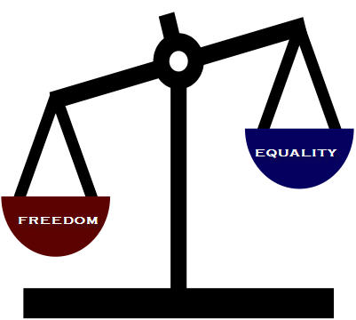
The State

Slide 2
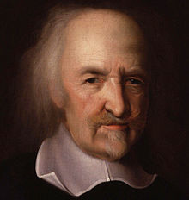
Life is nasty brutish and short.
Therefore, The State.
Thomas Hobbes (1588 - 1679)
Notes:
Consider what it felt like while playing musical chairs!

Slide 3
Are we naturally political?
Can we do without government?
Is there a distinction between legitimate and illegitimate authority?
Notes:
Should there be a state? What are our obligations to it?

Slide 4
How do we distinguish between legitimate and illegitimate authority?
Is revolution ever justified?
If yes, under what conditions?
Notes:
Use these questions to draw out preliminary concepts and use the whiteboard to record student responses. Encourage discussion on differences. Take a few minutes.

Slide 5
Why are members of political collectives bound to submit to the laws of these political collectives?
Notes:
There can be a number of responses, particularly if you have an international student body. The range of assumptions can be quite broad, from the will of the people, to the barrel of a gun. After welcoming all reasonable ideas, perhaps suggest narrowing these assumptions to the western democratic ones.

Slide 6
Political Philosophy:
Assumes a state of authority exists.
Is concerned about the distribution of goods and services.
Notes:
We take for granted the existence of a state. We might disagree with specific policies or laws but we don’t usually question the state’s very existence.

Slide 7
The State
What is it?
Should there be one?
What kind?
What are its/our obligations to each other?

Slide 8
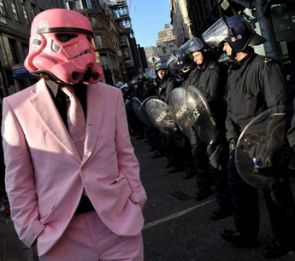
Consider, the State can:
Use Force
Take your Money
Keep you from drinking or smoking
Imprison or even Execute you
Notes:
The State has a monopoly on certain uses of force. Only the State can have a police force or an army. Only the State can imprison us, or wage war. It alone can tax us, redistribute wealth, not just for an army but for schools, roads health care, welfare etc.

Slide 9
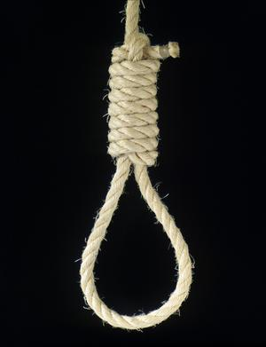
If you tried to do those things you'd be labelled a murderer and a thief.
Why is it okay for the State to do these things?
Notes:
The State also has unique claim on our obedience. Inside its borders I must behave a certain way or face punishment. I must pay taxes and serve in army at time of war if called up. As a child I must refrain from smoking and drinking or driving.
No other institution can do those sorts of things, and if they did, there would be riots in the streets.
How come the state gets to do that?

