Slide 1

Two Views of Society

Slide 2
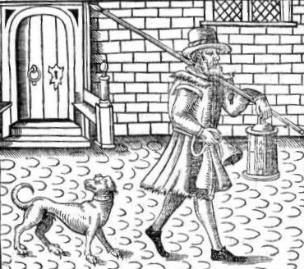
Nozick: the Minimal State
The night watchman state
Protect from violence
Enforce contracts
That's it!
Notes:
Nozick, an American philosopher believes any law or tax except for the creation of a police force is a violation of our rights. If we want to ride motorcycles without helmets, or pay athletes exorbitant fees, or associate with certain persons and not others, what business is it of anyone? In order to make things ‘equitable’ the state will have to become a meddling dictatorship, constantly interfering and redistributing goods and issuing tickets.

Slide 3
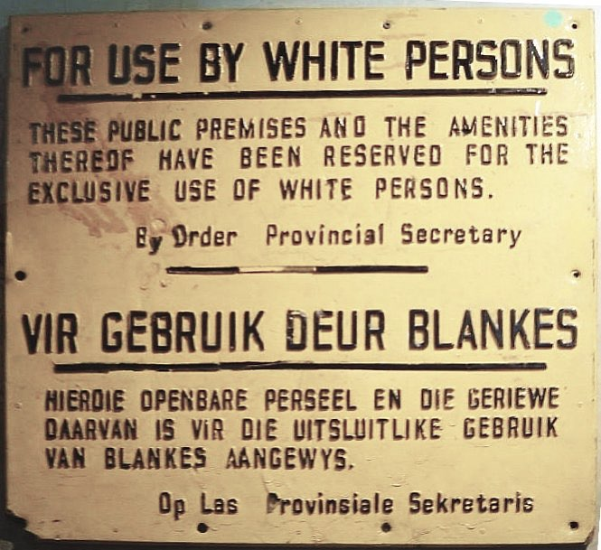
You can't force people to:
Censure
Pay for schools or roads or retirement etc.
Hire people of different race or ethnicity
Notes:
Depending, this may be a good time to ask students if they see any problems with Nozick’s vision of the Night Watchman state? A Night Watchman was the person paid by the village to patrol at night to keep criminals and wolves at bay, historically. This image gives a hint at what issues might immediately come to mind.

Slide 4
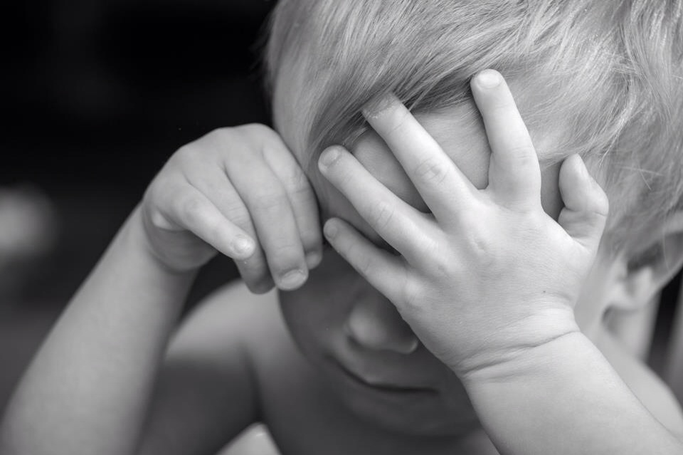
Does this seem unfair?
Why?
Notes:
See if students can come up with notions of discrimiation, gender bias, racism, economic disparity, monopolies, etc as problems not addressed by Nozick. Still, they may feel they earned their marks, don’t people earn their place in society?

Slide 5
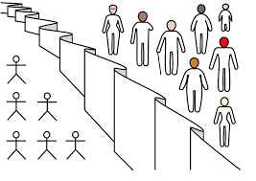
Rawls:
The Veil of Ignorance
Devise the rules of society while not knowing who will be rich or poor.
Notes:
Rawls, a philosopher who would be in disagreement with Nozick, suggests a thought experiment: Imagine a meeting of all the people who will become a new society, but they don’t know who or what they will be once the society begins. How would they design society? Answer: it would be designed to minimize suffering and be less concerned with entitlement. Think of our grade game earlier.

Slide 6
Equality Principle
The greatest personal freedom without impinging on other's freedom
Notes:
Racism and discrimination is clearly an impingement...

Slide 7
Difference Principle
Doctors get paid more than labourers, but doctors benefit society more, and
High salaries offset long years of medical school.
Medical School is open to all, theoretically.
Notes:
Difference and economic benefit can occur, in Rawl’s view, if that inequity benefits even the poorest in the societ. So doctors get paid more, but we all are healthier.

Slide 8
The two views of Justice compared:
Justice = Fairness says Rawls (Taxes & Civil Rights even the playing field. )
Justice = Entitlement (to honest gains) says Nozick

Slide 9
Back to our Grading Game:
Why wouldn’t you take the teacher’s grades?
If you are behind a “Veil of Ignorance” you will pick a principle of distribution that gives the most desirable distribution.
But is your method JUST?
Notes:
Is there a difference between fair and just? Would you want to live in a just society or a fair one?

Slide 10
My grading system would be the JUST method (according to Nozick), right? Assuming I’m perfectly competent and impartial…
You are ENTITLED to the grades you earned.
It is unjust to deny an A to someone who earned it.

Slide 11
So the Veil of Ignorance causes us to choose the system that minimizes our risk, not choose the just system (Nozick’s definition.)
Is this a flaw in the Veil of Ignorance model?
Maybe the Veil is only meant for Society as a whole, not smaller groupings like a classroom
It is in society’s best interest for students to earn their ‘A’s?

Slide 12
But what does it mean to “earn” something?
Is it just hard work?
Or is opportunity a factor?

